Slide 1
IXP Traffic Forecasting (time-series forecasting) with FL
Luca Bordin, Mattia Menegale, Francesco Cavalieri

Slide 2
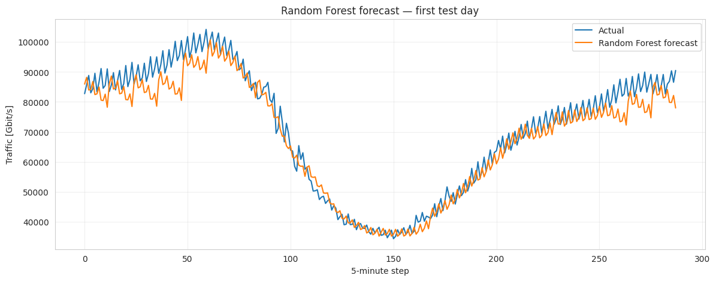
S1 — Load dataset, visualization & Analysis
Problem Definition
Prediction of future regional traffic using IXP traffic volume
The problem is a Regression problem where given a past recording interval of N predict the next K values, followed by a sensitivity analysis of the model performances.
N = {12,72,288}
K = {1, 12, 36}
9
N × K combinations
Train (70%)
Validation (15%)

Slide 3
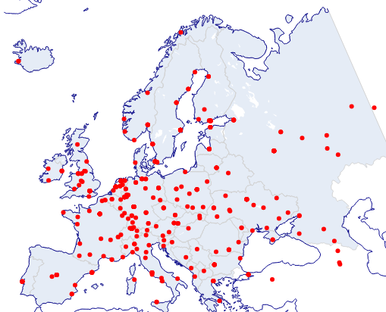
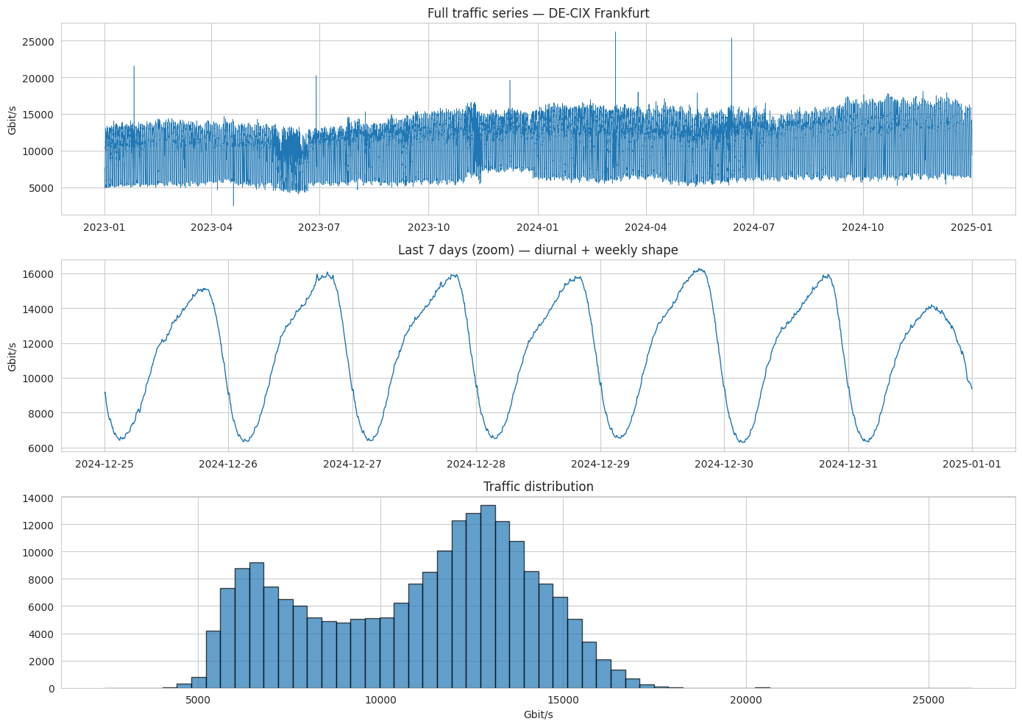
S1 — Load dataset, visualization & Analysis
Entities
Data
The project uses a collection of publicly available traffic statistics for Internet Exchange Points (IXPs), covering two years (January 2023 - December 2024).
The dataset has 472 IXPs worldwide and accounts for 87% of all publicly announced IXP port capacity.
Singular IXPs
The singular IXPs during the observable period shows different trends (DE-CIX Frankfurt) shows a periodic daily trend and a bimodal distribution of the load during his period
Train (70%)
Validation (15%)

Slide 4
S2
Preprocessing
Clean data, better models

Slide 5
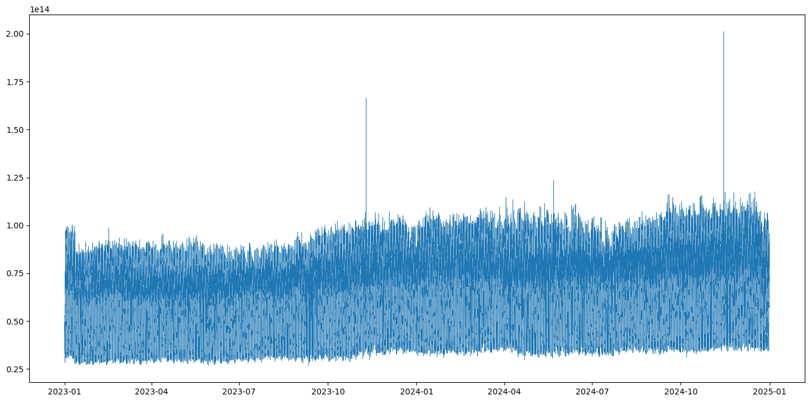
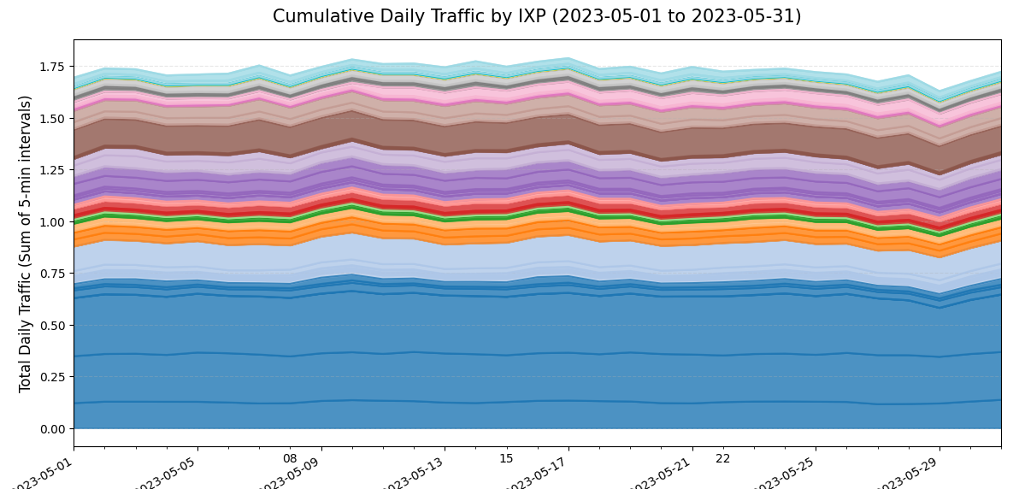
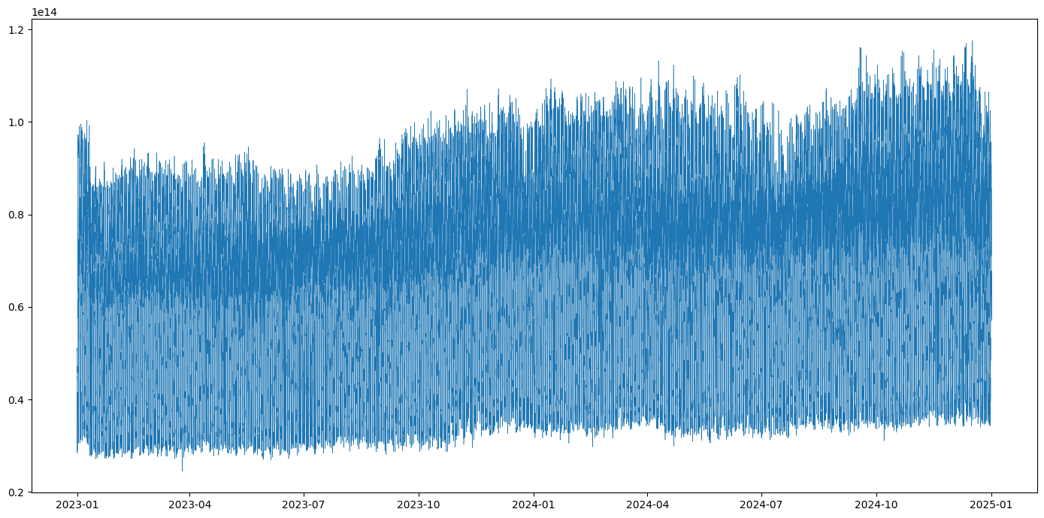
S2 — Preprocessing
Cleaning & Aggregation
Regional Traffic
The regression problem was set up using the aggregated traffic, grouped by timestamp and summed for each IXP. Therefore, we discarded the individual measurements, which were considered noisy data.
To establish a solid baseline for training the models, we developed an outlier detection method based on MAD (Median Absolute Deviation).
Train (70%)
Validation 15%)

Slide 6
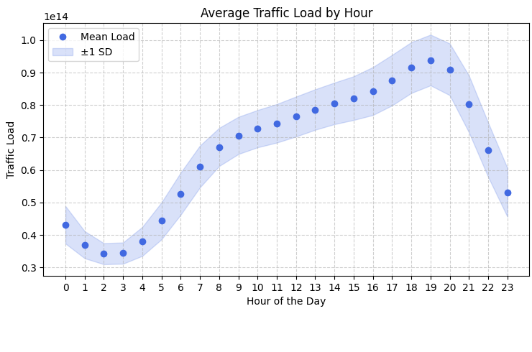
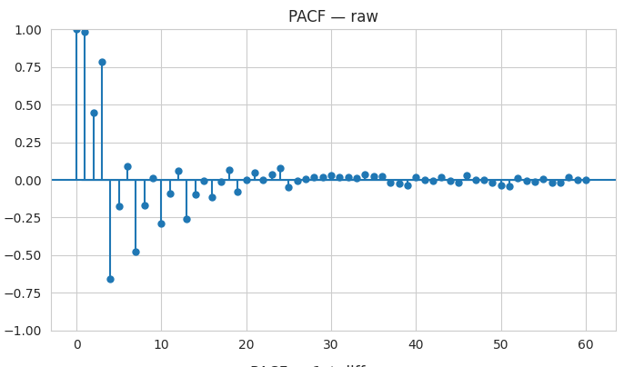
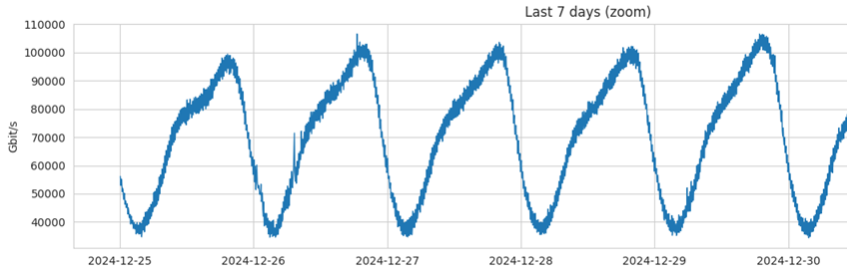
S2 — Preprocessing
Properties
Correlation and trends and other
The aggregated traffic exhibits high partial autocorrelation, making it well suited for autoregressive approaches. It also shows a daily periodic pattern, typically reaching its peak at 21:00 and becoming effectively uncorrelated after 7 time steps.
Train (70%)
Validation (15%)

Slide 7
S3
Forecasting Setup
Shared pipeline used by every model in S4

Slide 8
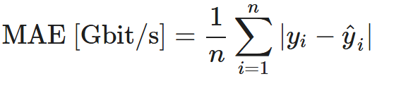
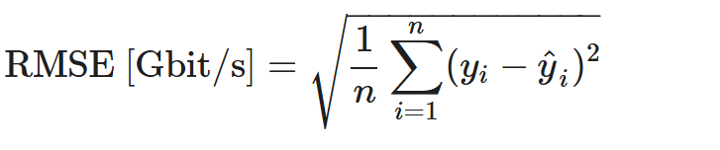
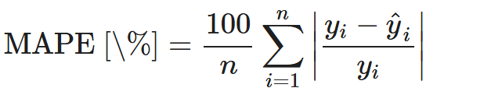
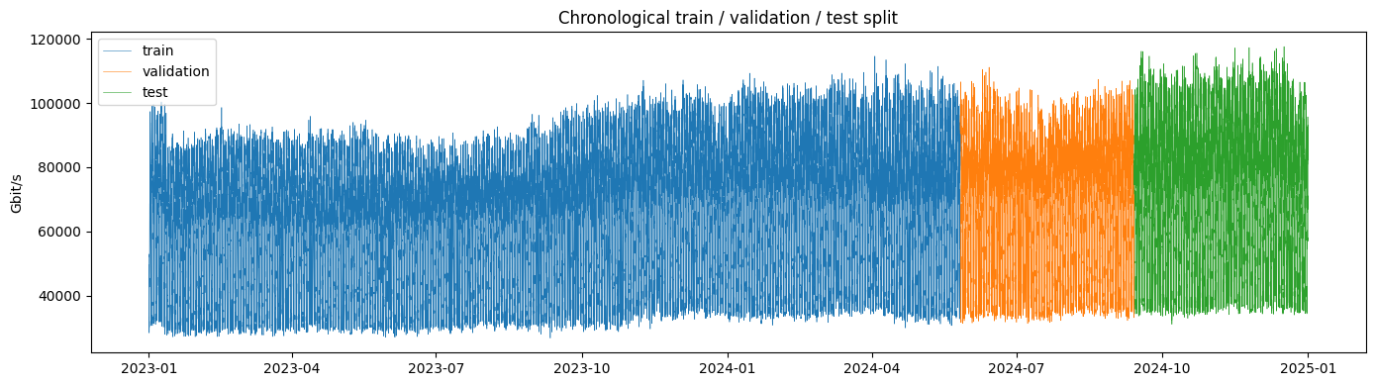
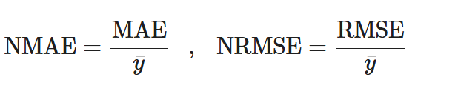
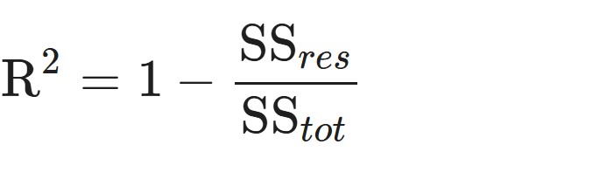
S3 — FORECASTING SETUP
Forecasting configuration, split & metrics
Sliding-window formulation
• Produced by using different stride strategies train-stride =3, validation and test = k_horizon
Evaluation metrics
Temporal split (70 / 15 / 15)
• Train → Validation → Test — strictly chronological, no future leakage
• Standardization fitted on training set only, using standard scaler
Train (70%)
Test (15%)
Validation (15%)

Slide 9
S4
Model Training & Comparison
Random Forest, LSTM, GRU, ARIMA, and Chronos TSFM

Slide 10
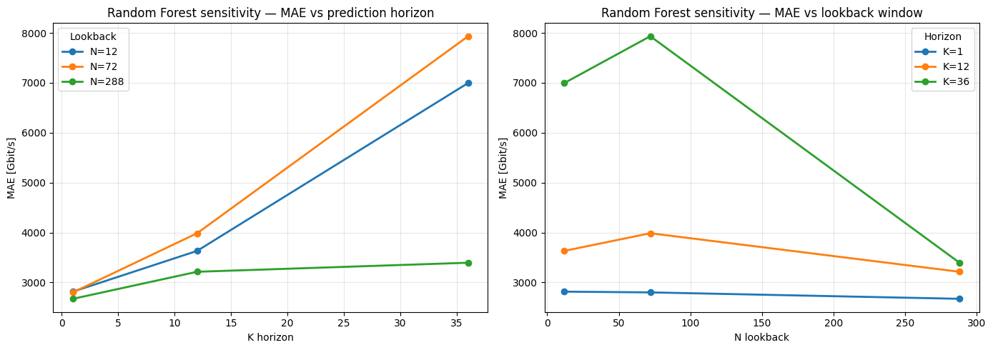
S4.1 — RANDOM FOREST BASELINE
Random Forest
How it works
• Machine learning model that uses an ensemble of decision trees to make predictions.
• Has no notion of time
• Tree capture non-linearity through their splits
• 200 trees, direct multi-output (all K at once), parallel fitting
Test performance (N=72, K=12)
• MAE 3,986 | RMSE 5,624 | MAPE 5.26% | R² 0.933
• Training ~1,040 s — dominated by the many windows
Sensitivity findings
• N=288: big gain at K=36 (MAE 7933 → 3395)
• K=1: insensitive to N — recent values suffice
• Worst at (N=72, K=36) — too little context for 3h

Slide 11
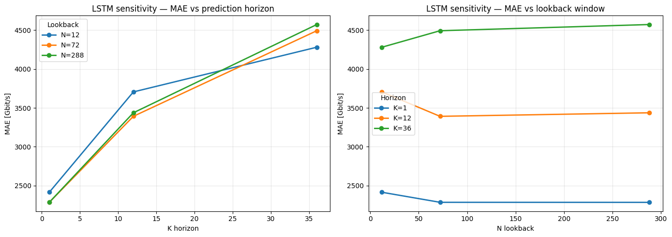
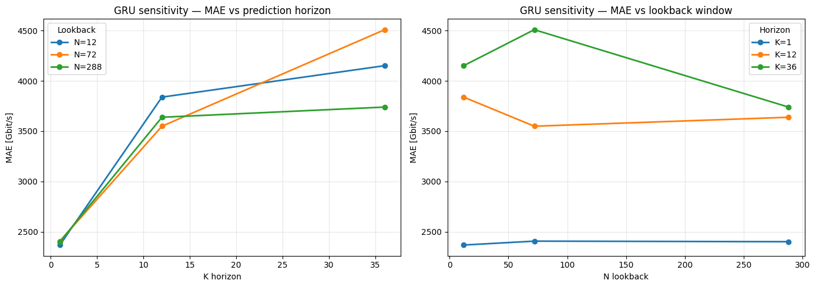
S4.2 / S4.3 — LSTM & GRU
Deep Learning — LSTM & GRU
Recurrent encoders
• Read the N-sample window as an ordered sequence (one value at a time); linear head → K outputs (direct)
• LSTM: 3 gates + hidden state + cell state (hidden 64, 1 layer)
• GRU: 2 gates, single state (hidden 128, 2 layers)
• Tuned via expanding-window CV — no future leakage
Test metrics (N=72, K=12)
• LSTM: MAE 3,371 | R² 0.965 (train 7.6 s)
• GRU: MAE 3,532 | R² 0.965 (train 30.4 s)

Slide 12
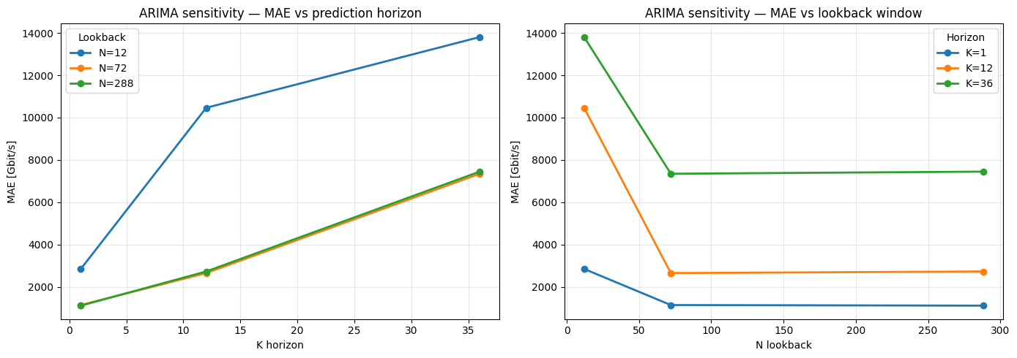
S4.4 — ARIMA
ARIMA(7, 1, 0)
Method
• AutoRegressive Integrated Moving Average
• Order ARIMA(7,1,0)
• Refit per-window on each window’s N context samples
Test performance (N=72, K=12)
• MAE 2,066 | MAPE 3.06% | R² 0.972 — best MAE of all models here
Sensitivity findings
• Dominates at K=1: MAE 973 (N=288), R² 0.995 — best overall
• N=12, K≥12: degrades badly (MAE up to 16,500) — too little context
• N≥72: stable and competitive up to K=12

Slide 13
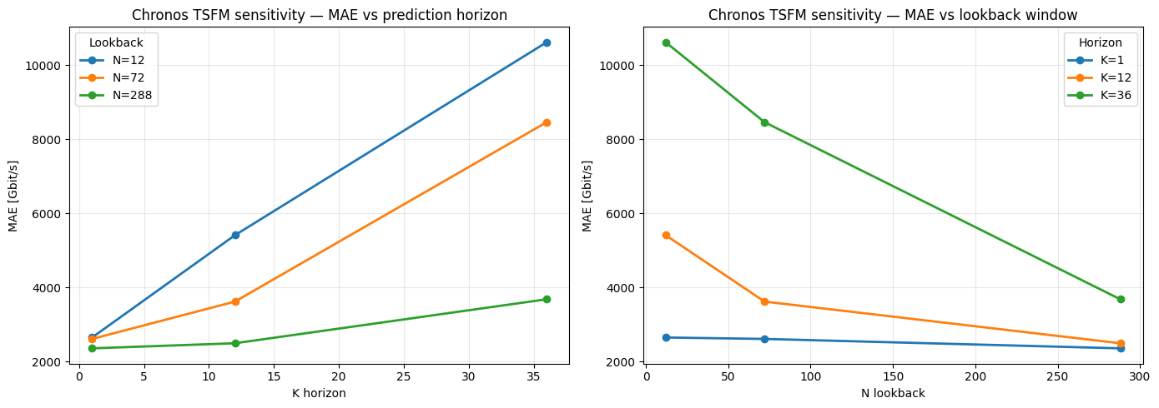
S4.5 — TIME SERIES FOUNDATION MODEL
Chronos-Bolt — zero-shot forecasting
Zero-shot TSFM
• Transformer pretrained on millions of series
• amazon/chronos-bolt-small (~48M params), T5 encoder-decoder
• Context = N samples, horizon = K; no fine-tuning
Test performance (N=72, K=12)
• MAE 3,616 | MAPE 5.22% | R² 0.953 — on par with LSTM/GRU, zero training
Sensitivity findings
• Long context helps: N=288 cuts MAE 50%+ vs N=12 at K=36
• Best: N=288, K=1 — MAE 2,354, R² 0.982
• N=288, K=36: MAE 3,678 — 2nd best, zero training

Slide 14
S4.6
Final Model Comparison
Bringing all five models together

Slide 15
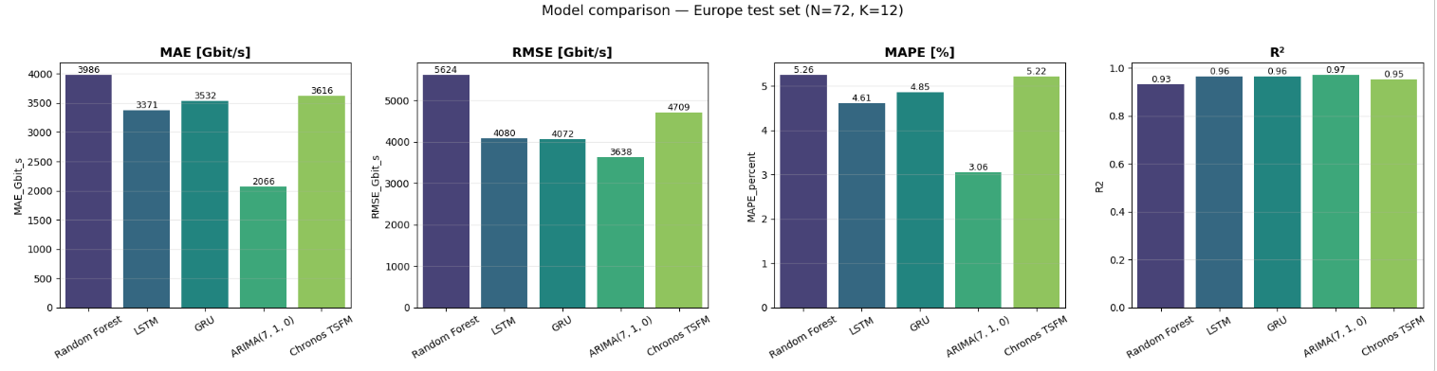
S4.6 — FINAL COMPARISON
Model comparison & forecast overlay (N=72, K=12)
Ranking at default setting
• MAE: ARIMA 2066 < LSTM 3371 < GRU 3532 < Chronos 3616 < RF 3986
• R²: ARIMA 0.972 > GRU 0.965 ≈ LSTM 0.964 > Chronos 0.953 > RF 0.933
• ARIMA leads on all metrics; RF weakest but still R² > 0.93

Slide 16
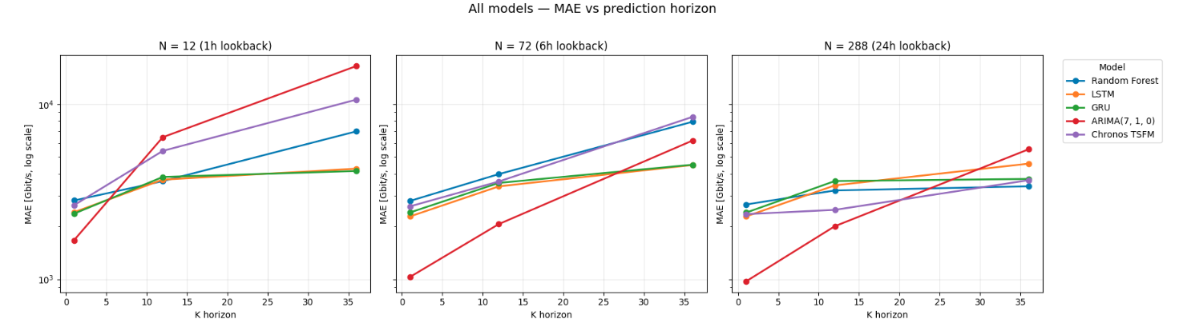
S4.6 — FINAL COMPARISON
Sensitivity (MAE vs K) and best configuration
What the line plots tell us
• N=12: ARIMA diverges at long K; LSTM/GRU most stable
• N=72: all competitive; ARIMA leads at K=1
• N=288: RF catches up, Chronos becomes top-tier
• LSTM/GRU most consistent across (N,K)

Slide 17
Federated Learning
FedAvg across Jakarta IXPs with a shared GRU forecaster

Slide 18
Task
Goal
• Simulate FL across Jakarta's IXPs, the goal was to use 15 IXPs in total, and hold out 3 for testing.
3 models
• Federated model (FedAvg): one global GRU shared across clients.
• Centralized: one GRU trained on the pool of all participants' (standardized)
data (this should work as the practical upper bound).
• Local-only: one independent GRU per test client, trained only on that client's data.
15
Jakarta IXPs
FL
task
3
models compared

Slide 19
From PeeringDB to 13 IXP clients
Geographic filtering via PeeringDB
• Dataset metadata has IXP IDs but no geography → PeeringDB maps IDs to cities
• 77 Indonesian IXPs → 34 in greater Jakarta (Jabodetabek tokens + mislabel whitelist)
Building the candidate pool (target: 15)
• Only 6 Jakarta IXPs have a traffic profile in the dataset
• Filled spots with other Indonesian IXPs
• Obtained 16 IXPs in total
Zero-traffic drop
• Mean < 0.05 Gbit/s → dead exchange: no learnable pattern, degenerate standardization, NMAE% blows up
• 3 discarded (SIX, BIX Semarang, IIX-Sulampua) → 13 usable clients
13
selected IXP clients
5 + 8
Jakarta + other Indonesian
0.05
Gbit/s dead-IXP threshold

Slide 20
Clients, splits and standardization
Train / held-out client split
• 10 training clients + 3 held-out IXPs that never join any round: IIX-Bali, sumIX, IIX-Jateng
• Held-out set stratified by coefficient of variation (0.23 / 0.58 / 1.19) — spans low, medium and high variability
Per-client datasets
• Temporal split 60 / 10 / 30 (train / validation / test) — strictly chronological, no future leakage
Standardization
• To compare data farly we used Z-standardization:
for a client’s data portion (no leakage):
transformed_data = (datum_value - data_mean) / data_std
10
training clients
3
held-out test IXPs
60/10/30
temporal split

Slide 21
Experimental Setup
Granularity = 1-hour
• The raw dataset is at 5-minute granularity.
• Rescaled data to 1-hour granularity, faster training, keeps the sequence length manageable for a small GRU
N Lookback = 24 hours
• As IXP traffic is strongly periodic with a ~24h period
• So model can "see" where in the daily pattern it currently sits and what comes next
K Horizon = 6 hours
• Practical forecasting window, predicting further out (12h, 24h) is harder
• Contains training speed and parameters as the linear head outputs just 6 values), which means fewer parameters sent over the network each FL round
1 h
time series granularity
24h
lookback value
6 h
horizon value

Slide 22
Evaluation Metrics
Scale-free metrics for fair comparison across IXPs ranging from 0.1 to 4,400 Gbit/s
Why not MAE / RMSE?
Both are in Gbit/s — an error of 5 Gbit/s looks tiny on a 4,400 Gbit/s IXP but huge on a 0.1 Gbit/s one.
Raw errors are not comparable across clients of different sizes, so we use scale-free alternatives.
NMAE% and NRMSE% (Normalized error)
Error divided by each IXP's own mean traffic evel.
Turns Gbit/s into a percentage of typical load.
R² (Shape accuracy)
Does the model capture the ups and downs of the true signal?
model 1.0 = perfect match, 0.0 = no better than the mean, < 0 = actively wrong
Skill vs Persistence (Beat the naive baseline?) (Skill = 1 − (model MAE / naive MAE))
Does the model beat simply repeating the last observed value?
> 0 => genuinely useful, = 0 => same as naive, < 0 => worse

Slide 23
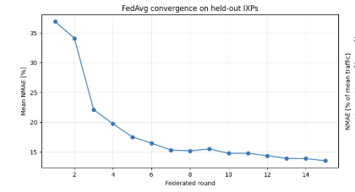
Federated Learning setup (FedAvg + proximal term)
FedAvg (15 rounds)
• Server sends the current global model weights to all training clients.
• Each client loads those weights, trains locally for 2 epochs on its own data,
and sends the updated weights back.
• Each client trains 2 local epochs on its own standardized windows
• Server averages the weights, weighted by each client's dataset size.
FedProx regularization term (μ = 0.01) for non-IID
• We added a small FedProx regularization term that penalizes each client's local model from drifting too far from the global model
15 2 μ=0.01
federated local FedProx coefficient
rounds epochs/round

Slide 24
Mean over held-out IXPs (scale-free)
Model | NMAE [%] | NRMSE [%] | R² | Skill vs persistence
Local | 11.35 | 15.73 | 0.022 | −6.22
Federated | 13.55 | 18.74 | −6.01 | −16.92
Centralized | 13.42 | 18.17 | −0.99 | −10.45
Local wins on every single metric
• It has the lowest errors (NMAE 11.35%, NRMSE 15.73%), only positive R²( 0.022), least-bad skill score (-6.22).
R² is really bad
• Local's R² of 0.022 is barely positive, Centralized at -0.99 is negative.
• Federated at -6.01 is catastrophically negative => its predictions go in the wrong direction more often than just guessing
the flat average.
All three skill scores are negative
• It would literally be better saying "traffic in the next 6 hours will be exactly what it is right now" than using any of these
models

Slide 25
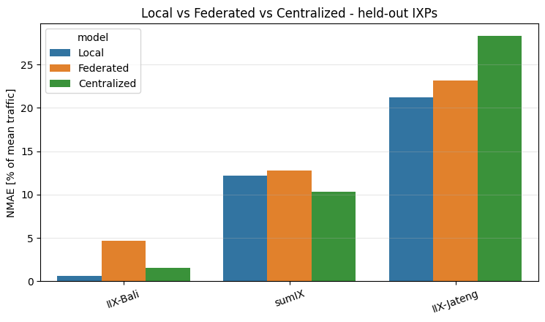
Three-way comparison: Mean Results across the 3 held-out IXP
The three IXPs behave completely differently
IIX-Bali (low variability, CV = 0.23 => smooth, predictable series):
• Local is almost perfect at ~0.6% error (wins)
• Federated jumps to ~4.7% because the global model has been contaminated with patterns from 10 very different IXPs.
• Centralized (~1.6%) is better than Federated
sumIX (medium variability, CV = 0.58):
• Centralized actually wins
IIX-Jateng (high variability, CV = 1.19 => spiky series):
• Everything struggles here (21–28% error).
• Local is still best (~21%), Federated is in the middle (~23%), and Centralized is actually the worst (~28%).
• The high variability makes this series hard to predict, and pooling data from other IXPs actively hurts because the big, busy IXPs dominate the shared model.

Slide 26
Conclusions and Future work
IXPs are too different from each other
• The main issue is that the IXPs are too different from each other for a single shared model to work well.
• Federated learning's premise (clients share similar enough patterns to benefit from collaboration) doesn't hold here.
• The traffic profiles span four orders of magnitude and have very different variability, so averaging their model weights produces a compromise that isn't great for any of them.
Single-layer GRU with 24h lookback may not be the right architecture
• The fact that even Local models can't beat persistence (negative skill) suggests that a single-layer GRU with 24h lookback may not be the right architecture for this task, or that the hourly traffic patterns in these IXPs are genuinely close to a random walk where the best predictor really is "same as now."
Future work
• Further data preprocessing
• LOOCV
• Federated Learning specifically designed for non-IID data

